Slide 1
Basic Computer Science

Slide 2
Computer Fundamentals

Slide 3
Computer Fundamentals
An electronic device that accepts data and processes it into useful information.
There are two main aspects of the computer:
Input:
The data we enter the computer is called the input.
Inputs are raw facts for which we want the system to process and give us result.
Output:
The output is the result that the computer provides in return of the raw data entered.
Input
Process
Output

Slide 4

Computer Devices
Input Devices
Keyboard
Mouse
Output Devices
Monitor
Printer
Storage Devices
Processing Devices
Flash Memory
Local Drives
Mother Board
Microphone
Touch Screen
Light Pen
Web Camera
Speaker
CD
DVD
Optical Disk
Magnetic Type
Magnetic Disk
Processor
Random Access Memory
Read Only Memory
Switched Mode Power Supply

Slide 5
Computer Components
Whether it's a gaming system or a home PC, the five main components that make up a typical, present-day computer include:
A motherboard
A Central Processing Unit (CPU)
A Graphics Processing Unit (GPU), also known as a video card
Random Access Memory (RAM), also known as volatile memory
Storage: Solid State Drive (SSD) or Hard Disk Drive (HDD)

Slide 6
Computer Memory
The performance of computer system depends upon the memory and CPU. CPU is capable to store only instructions required to operate the computer. Therefore, it is mandatory to have the memory to run a computer properly.
Memory is a set of memory cells known as building block of memory. Each memory cell has a unique index number or identification number known as the unique address of that specific memory cell.
A computer system is built using a combination of these types of computer memory, and the configuration can be optimized to produce the maximum data processing speed or the minimum cost, or some compromise between these two.

Slide 7
Computer Memory Hierarchy
Computer Memory
Primary Memory
RAM
ROM
Secondary Memory
HDD
SRAM
DRAM
SSD

Slide 8

Number System
Number systems are the technique to represent numbers in the computer system architecture, every value that you are saving or getting into/from computer memory has a defined number system.
Computer architecture supports following number systems.
Binary number system (Base – 2)
Octal number system (Base – 8)
Decimal number system (Base – 10)
Hexadecimal (hex) number system (Base – 16)

Slide 9
Number System
Number system | Base | Used digits | Example | Language assignment
Binary | 2 | 0,1 | (11110000)₂ | int val=0b11110000;
Octal | 8 | 0,1,2,3,4,5,6,7 | (360)₈ | int val=0360;
Decimal | 10 | 0,1,2,3,4,5,6,7,8,9 | (240)₁₀ | int val=240;
Hexadecimal | 16 | 0,1,2,3,4,5,6,7,8,9, A,B,C,D,E,F | (F0)₁₆ | int val=0xF0;

Slide 10
Operating System

Slide 11
What is an Operating System?
An Operating System is a System Software that handles the resources of a computer such as computer hardware and software. In other words, an operating system is defined as a software that creates an interface between the user and computer hardware.
To run any program or application, at least one operating system is important in computer system. An application i.e., MS word, chrome, games, etc. requires an environment so that the application can run and perform its functions.
The communication between devices and applications can be easily done with the computer without knowing computer languages with the help of Operating System. Without the operating system, it is not possible to use any computer or mobile device.

Slide 12
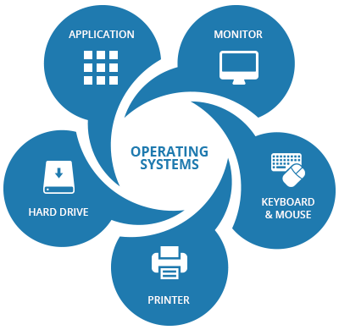
Operating System

Slide 13
Objectives of an Operating System
1
The operating system offers users an appropriate interface to use the computer system.
It helps us to hide the information related to the hardware resources from the users.
2
3
The operating system provides the sharing of resources among users and programs in an efficient way.
The operating system helps us to manage the computer system resources.
4
5
The operating system offers convenient & impartial sharing of resources between the users & programs.
The operating system is useful to monitor and handle the execution of other programs.
6

Slide 14
Features of an Operating System
Error Detecting Aids
File and Device Management
Security and Authentication
04
03
05
Processor Management
Job Accounting
02
06
Memory
Management
OS
Control over System Performances
01
07

Slide 15
Features of an Operating System
Main memory stores data and programs that can be lost when the system is turned off. It is also known as Versatile Memory.
A processor is defined as an integrated electronic circuit which performs the job of calculations in the computer.
Main Memory
Processor
System bus is responsible for communication b/w the processors, Input-Output modules, and main memory.
The task of I/O modules is to move the data within the computer to its peripheral external environment.
System Bus
I/O Modules

Slide 16
Network Fundamentals

Slide 17
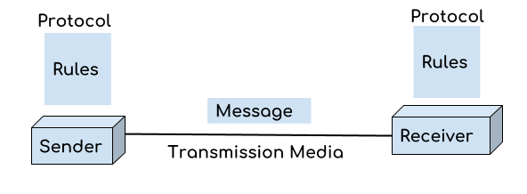
Introduction to Computer Networks
A computer network is a group of devices connected with each other.
The transmission medium between devices can be wires, cables etc.
These devices can be computers, printers, scanners, Fax machines etc.
It helps in sending and receiving data stored in devices over the network.
These devices are often referred as nodes.

Slide 18
Computer Networks Features
Performance
Data Sharing
Backup
Reliable
Security
Scalability
Software/Hardware Compatibility

Slide 19
Computer Networks: Performance
It can be measured in the following ways:
Transit time:
It is the time taken to travel a message from one device to another.
Response time:
It is defined as the time elapsed between enquiry and response.
Other ways to measure performance are :
Efficiency of software
Number of users
Capability of connected hardware

Slide 20
Communication Model
Source
Destination
Transmitter
Transmission System
Receiver
Model | Description
Source | Data to be transmitted is generated by this device, example: telephones, personal computers etc.
Transmitter | Transforms and encodes the data in such a form to produce electromagnetic waves or signals.
Transmission System | A transmission system can be a single line or a complex network connecting source and destination.
Receiver | Accepts the signal from the transmission system and converts it into a form managed by the destination.
Destination | Destination receives the incoming data from the receiver.

Slide 21
Network Topology
Based on Geographical Area Covered
LAN
WAN
Based on Architecture
Bus Topology
Star Topology
MAN
Ring Topology
Tree Topology
Mesh Topology
Hybrid Topology
A computer network is a collection of two or more computers or nodes which are considered as senders and receivers to share information and resources.
They are divided into two categories:
Geographical areas covered
Network architecture.

Slide 22
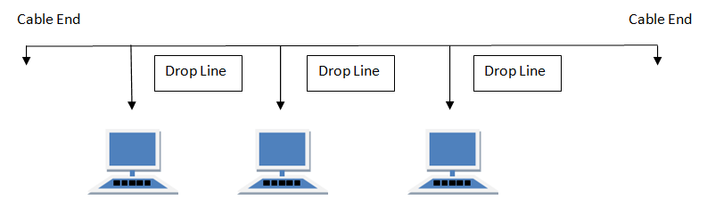
Bus Topology
Bus topology is a network type in which every computer and network device is connected to single cable. When it has exactly two endpoints, then it is called Linear Bus topology.

Slide 23
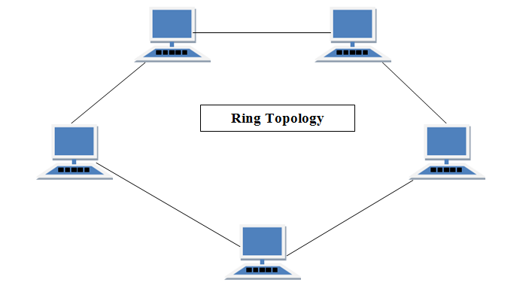
Ring Topology
It is called ring topology because it forms a ring as each computer is connected to another computer, with the last one connected to the first. Exactly two neighbors for each device.

Slide 24
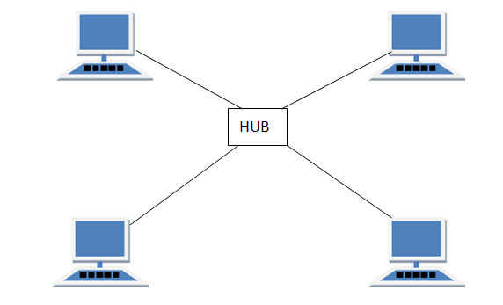
Star Topology
In this type of topology all the computers are connected to a single hub through a cable. This hub is the central node, and all other nodes are connected to the central node.

Slide 25
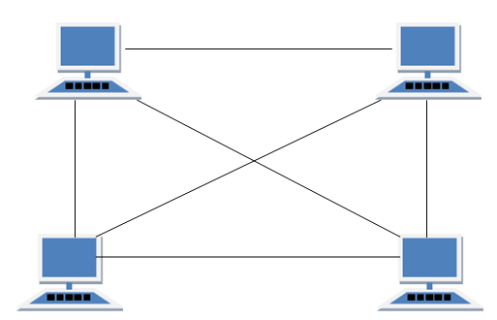
Mesh Topology
It is a point-to-point connection to other nodes or devices. All the network nodes are connected to each other. Mesh has n(n-1)/2 physical channels to link n devices.

Slide 26
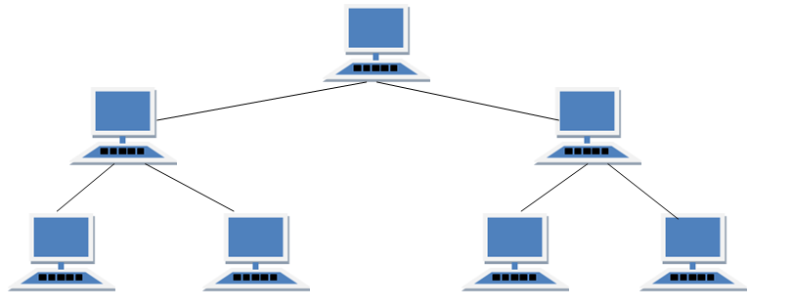
Tree Topology
It has a root node, and all other nodes are connected to it forming a hierarchy. It is also called hierarchical topology. It should at least have three levels to the hierarchy.

Slide 27
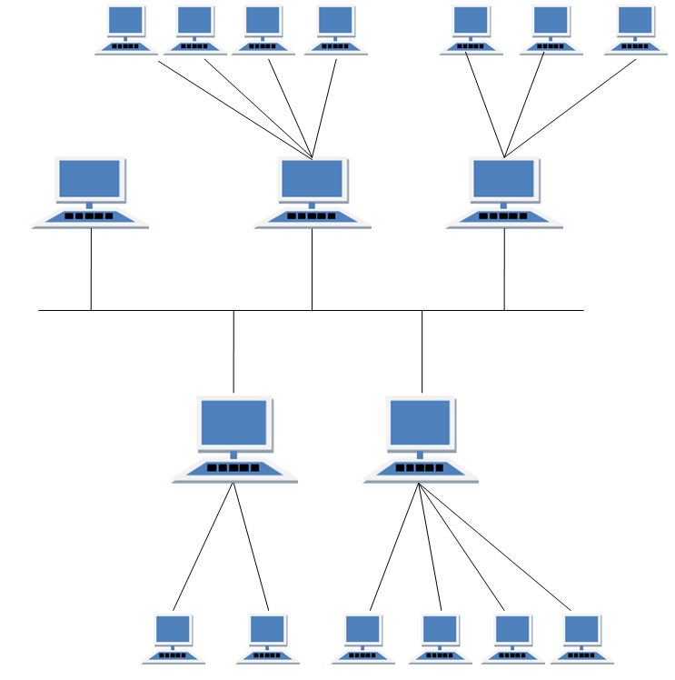
Hybrid Topology
It is two different types of topologies which is a mixture of two or more topologies. For example, if in an office in one department ring topology is used and, in another star, topology is used, connecting these topologies will result in Hybrid Topology (ring topology and star topology).

Slide 28
Computer Network Types
A computer network is a group of computers connected with each other through a transmission medium such as cable, wire etc.
A computer network can be categorized by their size.
A computer network is mainly of four types:
Computer Networks
LAN
MAN
WAN

Slide 29
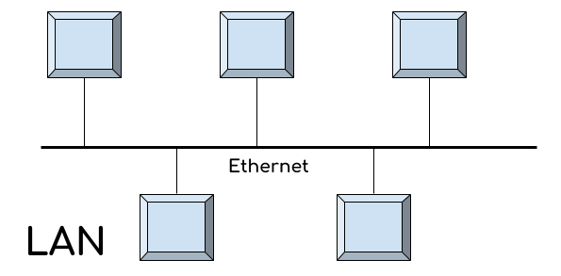
LAN (Local Area Network)
LAN is a group of computers connected with each other in a small places.
This network is best suited for school, hospital, apartment etc.
Due to its small size LAN works faster, and its speed lies between 100 to 100Mbps.
LAN can transfer the data with the speed ranging from 4 to 16 (Mbps).

Slide 30
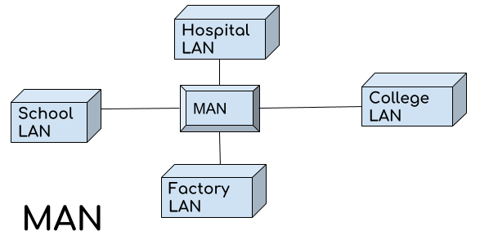
MAN (Metropolitan Area Network)
In MAN, various LANs are connected with each other through telephone lines.
It is mainly hold and operated by single private company or a public company.
The size of the MAN is larger than LANs and smaller than WANs.
A MANs covers the larger area of a city or town that is around 50 Kms.

Slide 31
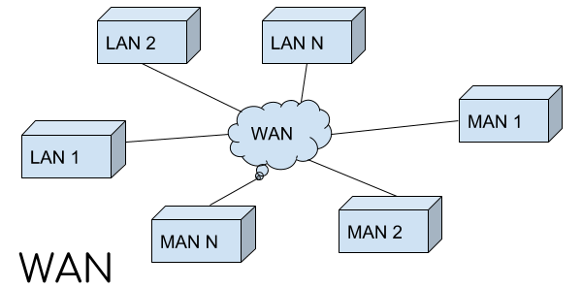
WAN (Wide Area Network)
Wide area network provides long distance transmission of data.
The size of the WAN is larger than LAN and MAN.
A WAN can cover country, continent or even a whole world.
Communication medium used by WAN are PSTN or Satellite links.
Some Examples are Internet and Broadband Mobile Connections such as 3G or 4G etc.

Slide 32
Transmission Modes
It refers to the mechanism of transferring the data between two devices.
These devices or nodes must relate/connect to each other.
Transmission Mode is also called Communication Mode.
These modes direct the direction of flow of information.
The transmission mode is defined in the physical layer.

Slide 33
Transmission Modes
The Transmission mode is divided into three categories:
Transmission Modes
Simple Mode
Half-Duplex Mode
Full-Duplex Mode

Slide 34
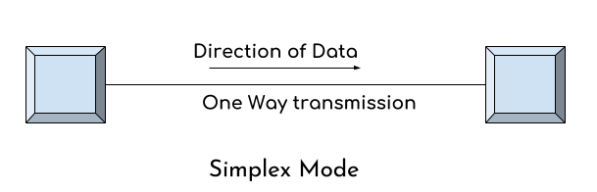
Simple Transmission Mode
In simplex mode the data transmits in one direction only.
This transmission mode is also known as unidirectional transmission.
The sender device can only send data and cannot receive it.
Whereas the receiver device can only receive the data and cannot send it.
E.g., Television demonstrates simplex mode.

Slide 35
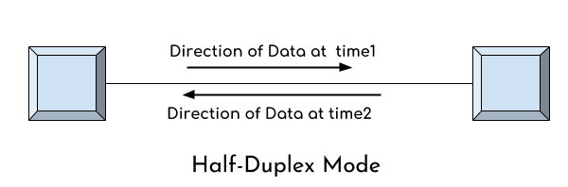
Half-Duplex Transmission Mode
In half duplex mode transmission can be done both ways.
Two connected devices can send and receive data at the different time.
Example of half duplex is a walkie- talkie in which message is sent one at a time but messages are sent in both the directions.

Slide 36
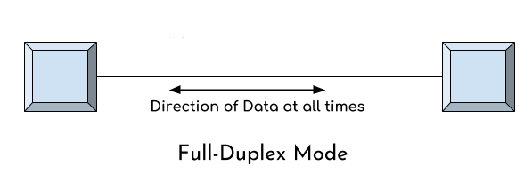
Full-Duplex Transmission Mode
In this mode, We can send data in both the directions at the same time.
No delays in communication as both can send and receive data simultaneously.
Example of Full Duplex is a Telephone Network i.e., communication between two persons by a telephone line, using which both can talk and listen at the same time.

Slide 37
Internet

Slide 38
Internet
A global system of interconnected computer networks.
It uses standard Internet Protocol(IP) suite to link several devices.
It is international network of networks.
They are linked by optical, wireless and electronic networking technologies.
Internet consists of business, public, educational and government networks.
It carries an extensive range of information resources. It utilize:
IP Addressing Scheme
Transmission Control Protocol (TCP)
Peer2Peer (P2P) Networks for file sharing

Slide 39
Intranet
An intranet is a private network that is contained within an enterprise.
It consists of interlinked LAN and use WAN for network connectivity.
The purpose of an intranet is to share company information among employees.
Intranet is usually created and maintained by a private organization.
The content of Intranet are intended for the members of organization.

Slide 40
Extranet
It uses internet protocols to link intranet over the public internet.
An extranet can be viewed as part of a company's intranet that is extended to users outside the company like suppliers, vendors, partners, customers, or other business associates.
For example, placing purchase order to registered vendors, billing & invoices, payments related activities, joint venture related activities, product brochures for partners, discounted price lists for partners etc.
Extranet can be used to:
Exchange large volume of data
Collaborate with partners & Peers
Share Product Catalogs

Slide 41
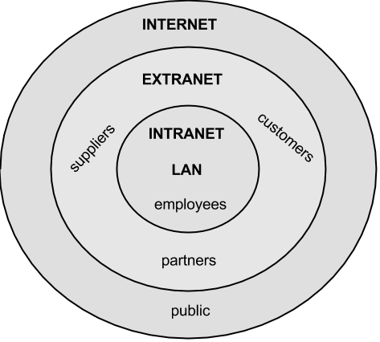
Internet, Intranet and Extranet

Slide 42
Email
Email is a way to send and receive messages across the Internet.
Each user of email is assigned a unique name for his email account.
E-mail is generally written as username@domainname.
For example, king.kochhar@abc.com is an e-mail address.
The username and the domain name are separated by @ (at) symbol.
E-mail addresses are not case sensitive.
Spaces are not allowed in e-mail address.

Slide 43
Advantages of Email
01
Productivity Tools
Email is usually packaged with a calendar, address book, instant messaging, and more for convenience and productivity.
If you want to sign up for an account like Facebook or order products from services like Amazon, you will need an email address so you can be safely identified and contacted.
Email service providers have tools that allow you to file, label, prioritize, find, group, and filter your emails for easy management. You can even easily control spam, or junk email.
You can send an email to multiple people at once, giving you the option to include as few as or as many people as you want in a conversation.
You don’t have to be at home to get your mail. You can access it from any computer or mobile device that has an Internet connection.
02
Access to Web Services
Easy Mail Management
03
Communication with People
04
Anywhere Anytime
05

Slide 44

WebMail Providers
The top three webmail providers are Yahoo!, Outlook.com, and Google's Gmail.
These providers allow you to access your email account from anywhere
There are several email service providers available in the market with their enabled features such as sending, receiving, drafting, storing an email and much more.
Gmail
Hotmail
Yahoo Mail
iCloud Mail
ATM Mail
Mail.com and GMX Mail
Shortmail
Inbox.com
Facebook Messages
My Way Mail

Slide 45
Computer Security

Slide 46
What is Computer Security?
It is the protection of computer systems and information from unauthorized use.
There are various computer security measures to protect the valuable information.
Computer security allows to use the computer while keeping it safe from threats.
Computer security is important because it keeps your information protected.
It’s also important for your computer’s overall health; proper computer security helps prevent viruses and malware, which allows programs to run quicker and smoother.

Slide 47
CIA Triad in Security
CIA – Confidentiality, Integrity, Availability
Confidentiality: Ensuring that the information is inaccessible to unauthorized people, commonly enforced through encryption, IDs and passwords.
Integrity: Safeguarding information and systems from being modified by unauthorized people, thereby ensuring that the protected data is accurate and trustworthy.
Availability: Ensuring that authorized people have access to the information when needed; this keeping them current with upgrades, using backups to safeguard against disruptions or data loss, etc.

Slide 49
Which of the following is not considered hardware?
1
Operating System
CPU
Keyboard
Hard Disk

Slide 50
Which of the following is not considered hardware?
1
Operating System
CPU
Keyboard
Hard Disk
A
The operating system (OS) is a software that acts as an interface between a computer and a user.

Slide 51
What is five main components of a computer system?
2
CPU, CD-ROM, Mouse, Keyboard, Sound card
Memory, Video card, Monitor, Software, Hardware
Modem, Keyboard, Word Processor, Printer, Screen
CPU, Memory, System bus, Input, Output

Slide 52
What is five main components of a computer system?
2
CPU, CD-ROM, Mouse, Keyboard, Sound card
Memory, Video card, Monitor, Software, Hardware
Modem, Keyboard, Word Processor, Printer, Screen
CPU, Memory, System bus, Input, Output
D
None

Slide 53
A term that refers to the way in which the nodes of a network are linked together.
3
Network
Topology
Connection
Interconnectivity

Slide 54
A term that refers to the way in which the nodes of a network are linked together.
3
Network
Topology
Connection
Interconnectivity
B
Topology is a term that refers to the way in which the nodes are connected. There are 4 major topology networks.

Slide 55
Which of the following isn’t a type of transmission mode?
4
Physical
Simplex
Full Duplex
Half Duplex

Slide 56
Which of the following isn’t a type of transmission mode?
4
Physical
Simplex
Full Duplex
Half Duplex
A
There are three modes of transmission: simplex, half duplex and full duplex.

Slide 57
The process of verifying the identity of a user.
5
Authentication
Identification
Validation
Verification

Slide 58
The process of verifying the identity of a user.
5
Authentication
Identification
Validation
Verification
A
It is called an authentication. It is typically based on passwords, smart card, fingerprint, etc.

